Slide 1


Data Analysis
This presentation provides an in-depth analysis of the Nykaa brand website, highlighting user engagement, traffic sources, and overall performance metrics to inform strategic improvements.
JUNE 2025

Slide 2
Nykaa Analysis Highlights
USER ENGAGEMENT
SALES TRENDS
MARKET POSITION
Nykaa's website sees high user interaction, with increased session times and frequent return visits from customers.
The brand experiences consistent growth in online sales, particularly during festive seasons and promotional events.
Nykaa holds a strong market position as a leading beauty and personal care e-commerce platform in India.

Slide 3

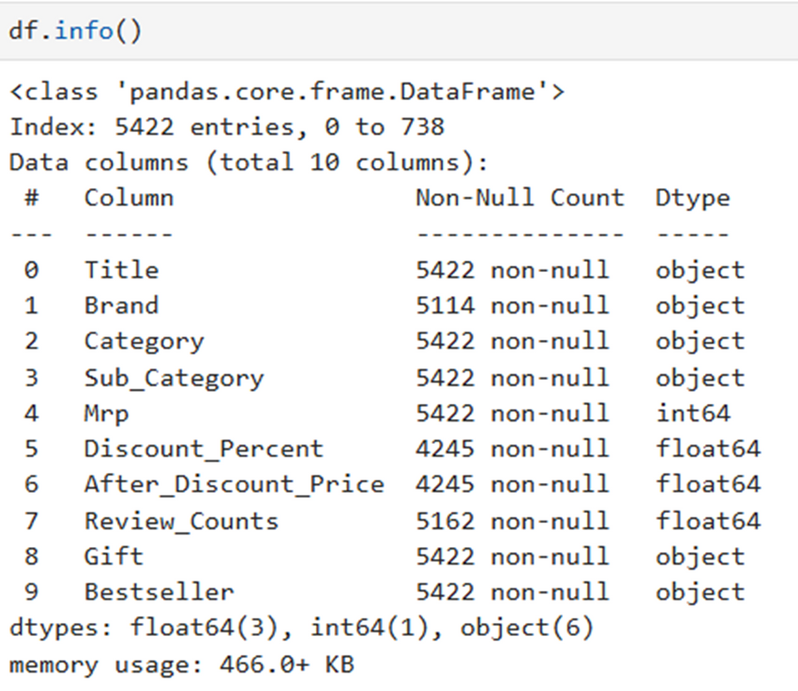


DESCRIPTION OF DATA:
Dataset Overview
The dataset contains “5422 entries” and “10 columns’’.
Memory usage is approximately “466.0 KB’’.
It includes both “categorical (object)” and “numerical (int64/float64)”features.
Column Summary
CATEGORICAL COLUMNS (6):
`TITLE`, `BRAND`, `CATEGORY`, `SUB_CATEGORY`, `GIFT`, `BESTSELLER`
NUMERICAL COLUMNS (4):
`MRP` (INT64), `DISCOUNT_PERCENT`, `AFTER_DISCOUNT_PRICE`, `REVIEW_COUNTS` (FLOAT64

Slide 4
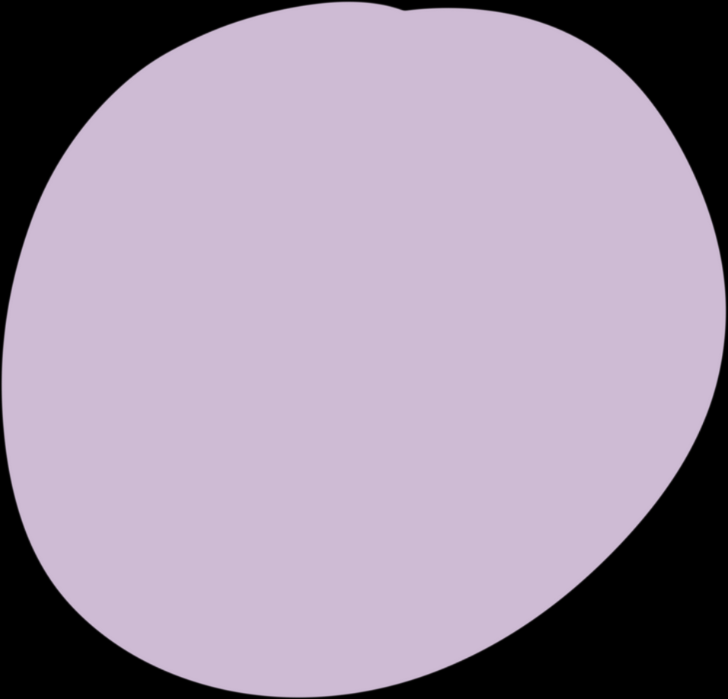
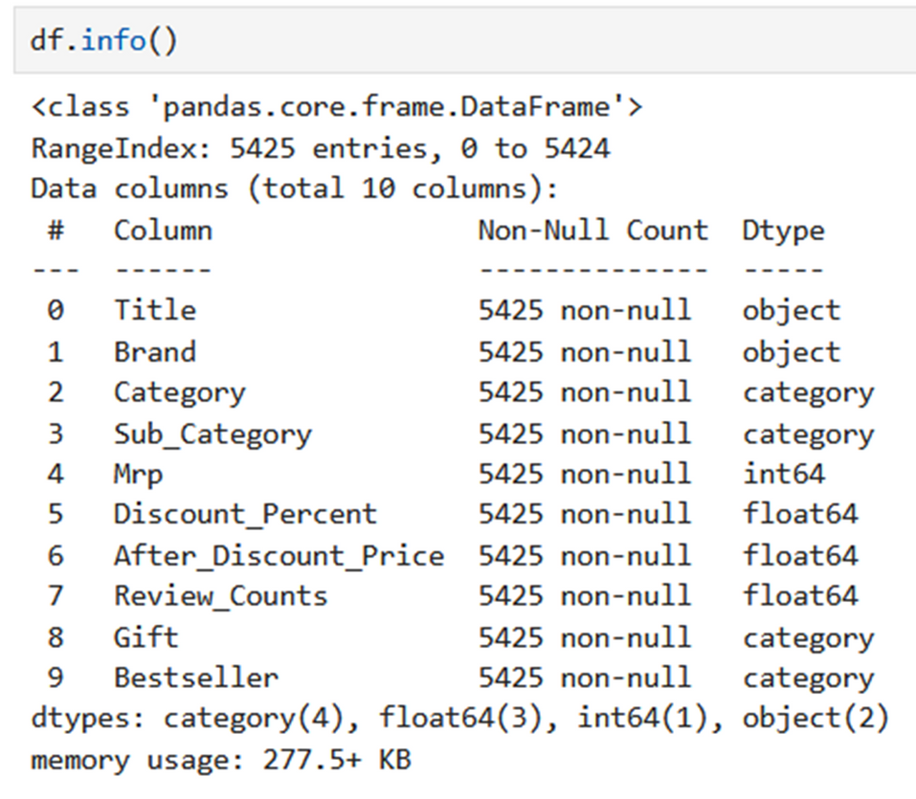

AFTER CLEANING:
Dataset Structure Summary:
Total Rows (Entries): 5422
Total Columns: 10
Memory Usage: Approximately 466.0 KB
Data Types Breakdown:
Object (Categorical): 6 columns
Integer (int64): 1 column → Mrp
Float(float64):3columns→Discount_Percent, After_Discount_Price, Review_Counts
Columns with Missing Data:
Brand: 308 missing entries
Discount_Percent: 1177 missing entries
After_Discount_Price: 1177 missing entries
Review_Counts: 260 missing entries

Slide 5
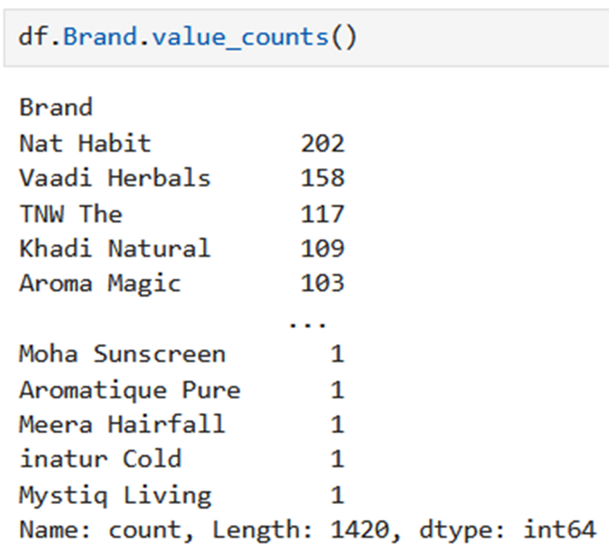
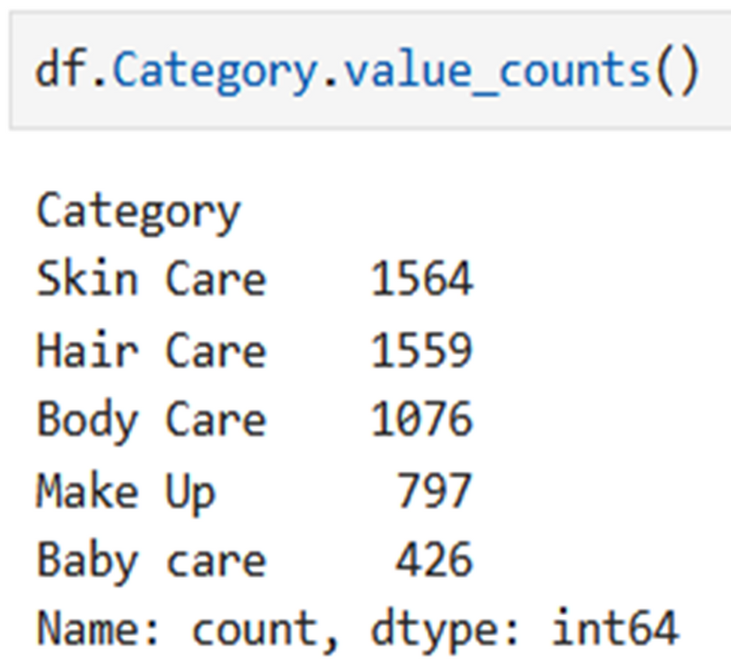
UNIQUE PRODUCT BRANDS:
UNIQUE CATEGORIES:

Slide 6

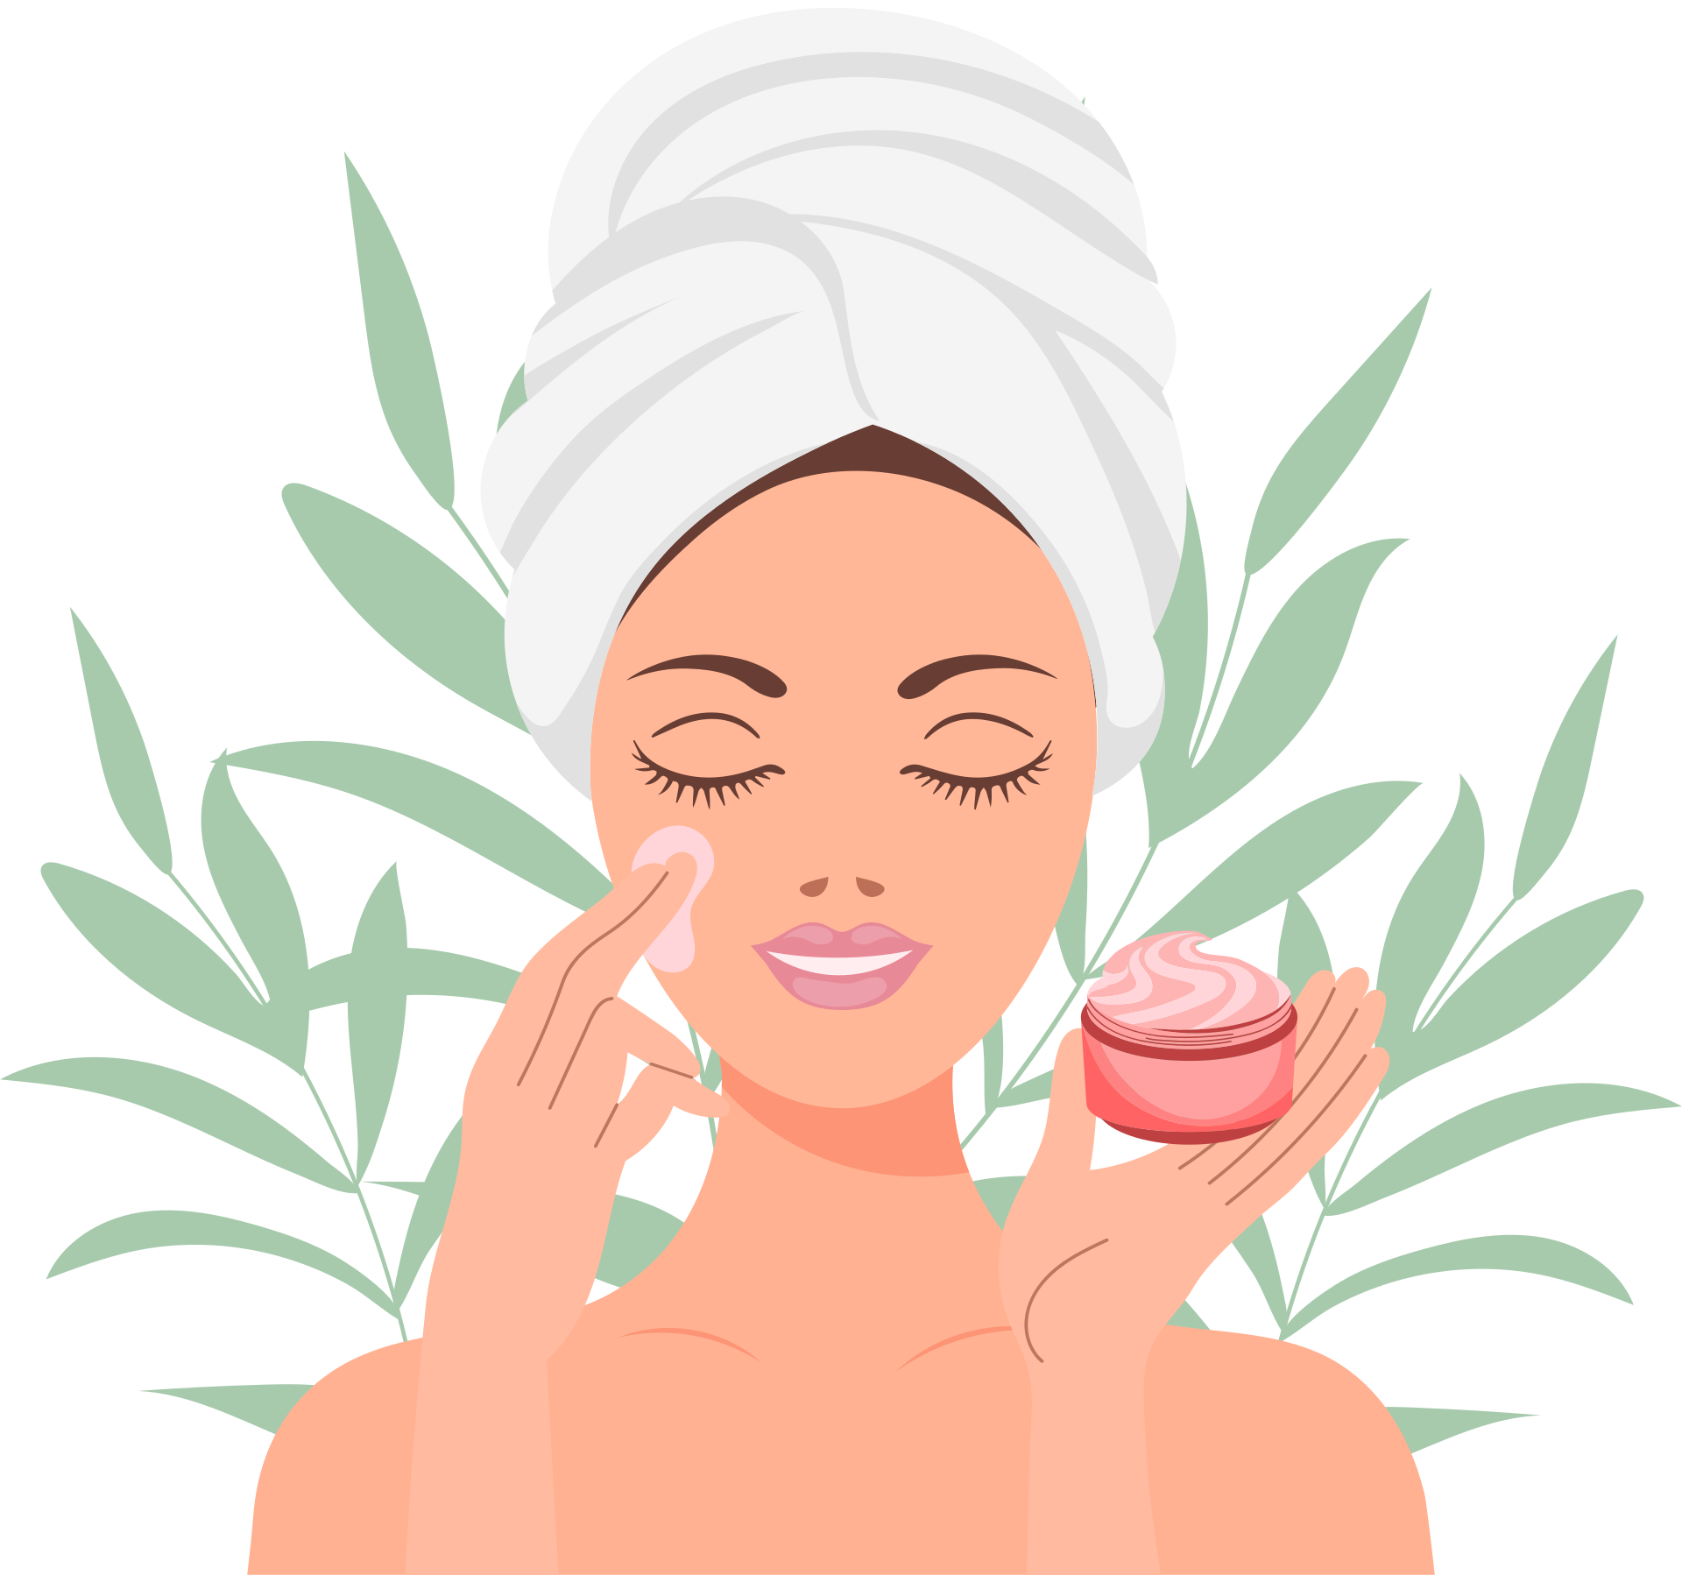
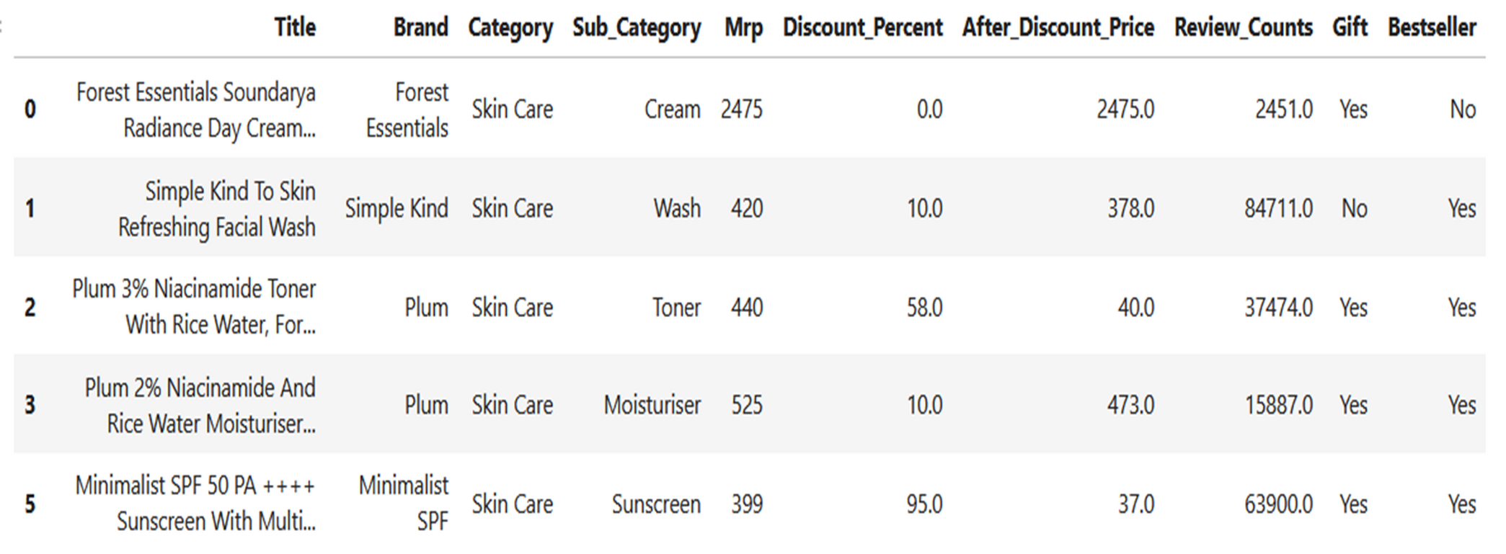



TOP 5 ENTRIES IN SKIN CARE:

Slide 7


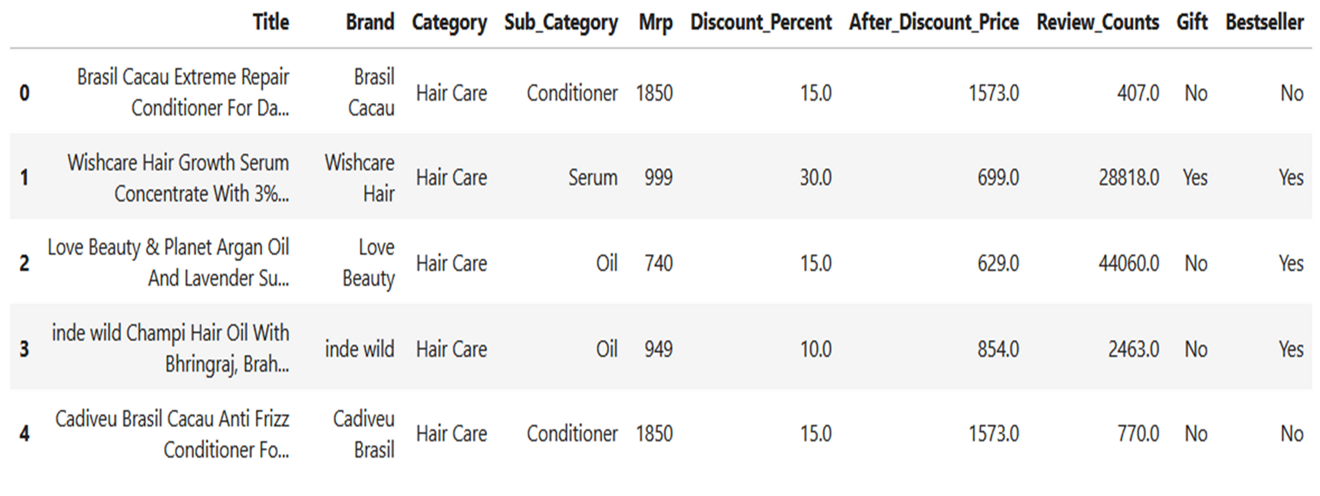
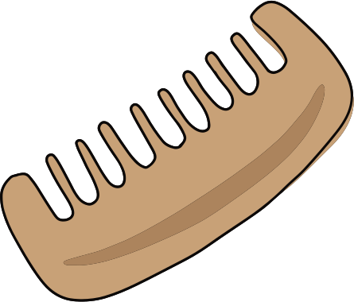
TOP 5 ENTRIES IN HAIR CARE:

Slide 8


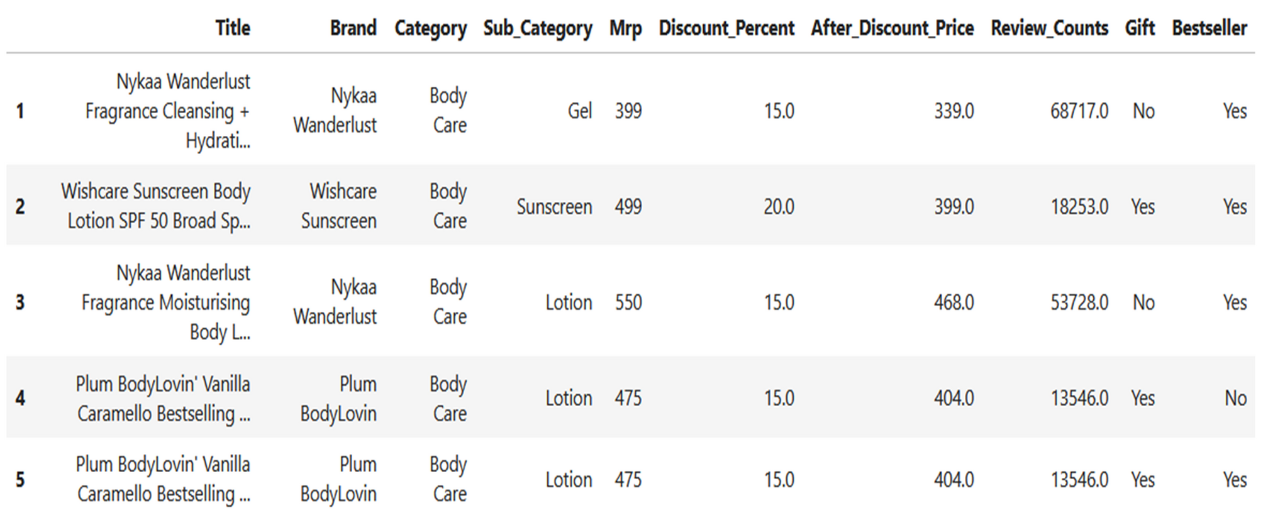

TOP 5 ENTRIES IN BODY CARE:

Slide 9
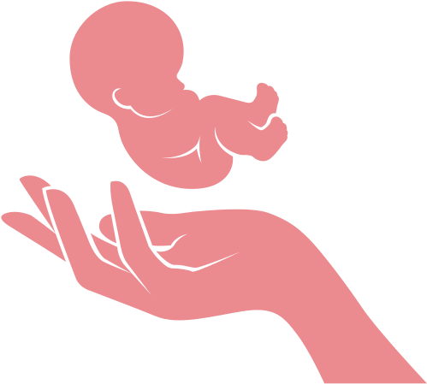

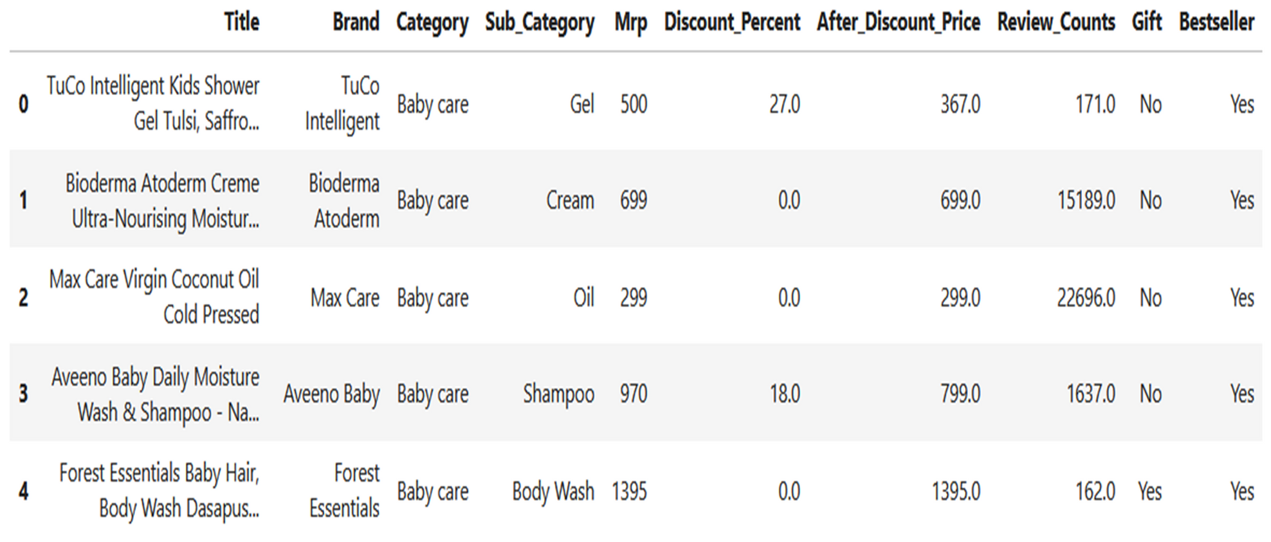

TOP 5 ENTRIES IN BABY CARE:

Slide 10
Analyze Nykaa's complete personal care product catalog—including skin care, hair care, body care, baby care, and makeup—by identifying top-performing sub-categories within each category, understanding price and rating distributions, evaluating brand dominance, detecting high-demand and fast-selling products, and determining the most reviewed and top-rated items.
The recent analysis shows a significant increase in monthly active users on the Nykaa brand website, reflecting the growing interest in online shopping for beauty products.
PROBLEM STATEMENT
Increased user engagement on site
Effective marketing strategies implemented
Enhanced product offerings attracting customers
Positive reviews boosting brand reputation

Slide 11
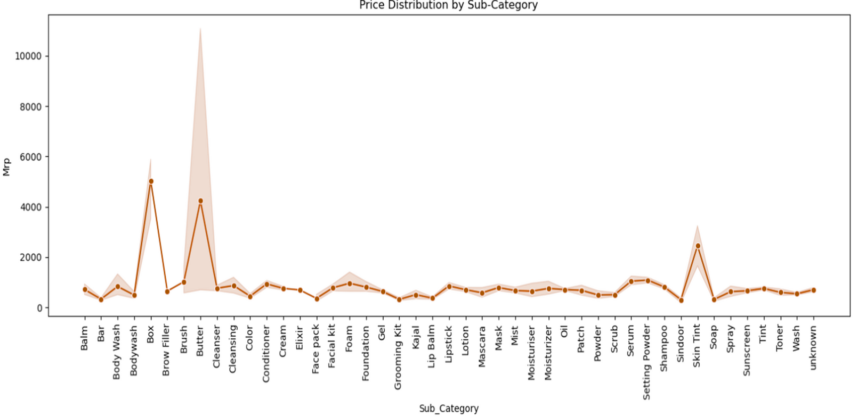
HOW ARE PRICES DISTRIBUTED ACROSS DIFFERENT SUB-CATEGORIES?
Most other sub-categories are priced under ₹1,000, indicating affordability across general product lines.
Sub-categories like Balm, Bar, Lip Balm, Kajal, Soap, and Toner have relatively low average MRPs, generally under ₹500.

Slide 12

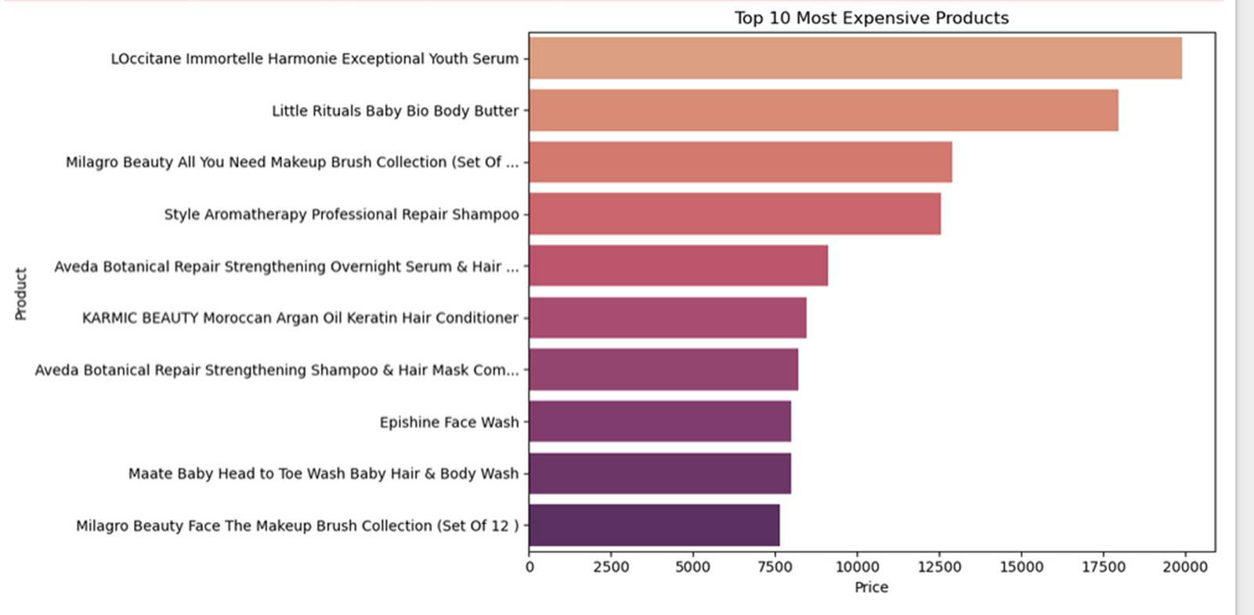


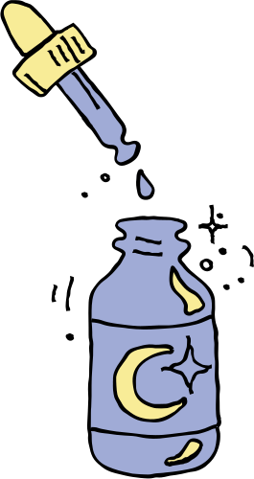
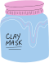
WHAT ARE THE TOP 10 MOST EXPENSIVE PRODUCTS?
Skincare and hair care dominate the luxury product segment.
Brands like L'Occitane, Milagro are positioned in the high-end/luxury market.
High prices are often associated with serums, oils, and specialized treatments.

Slide 13
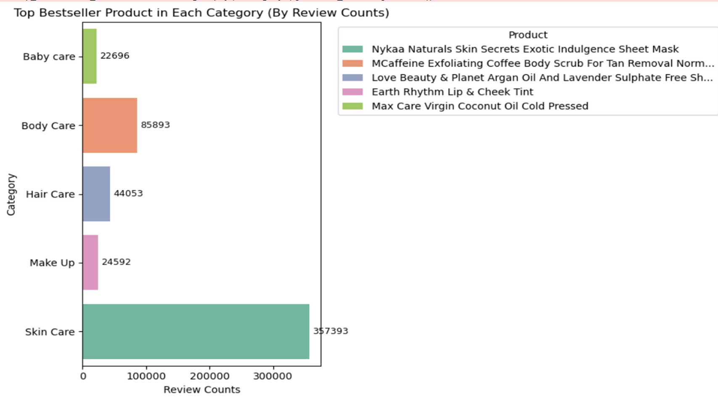
WHAT ARE THE BEST PRODUCTS IN EACH CATEGORY BASED ON REVIEW COUNTS?
Skin Care has the top-selling product overall: Nykaa Naturals Skin Secrets Exotic Indulgence Sheet Mask It has the highest review count (337,393), far ahead of others.
Body Care follows next, with over 85,000 reviews for: MCaffeine Exfoliating Coffee Body Scrub.
Hair Care's bestseller, Love Beauty & Planet Shampoo, has around 44,053 reviews. Make Up and Baby Care have relatively lower bestseller reviews, with around 24,592 and 22,696 respectively.

Slide 14

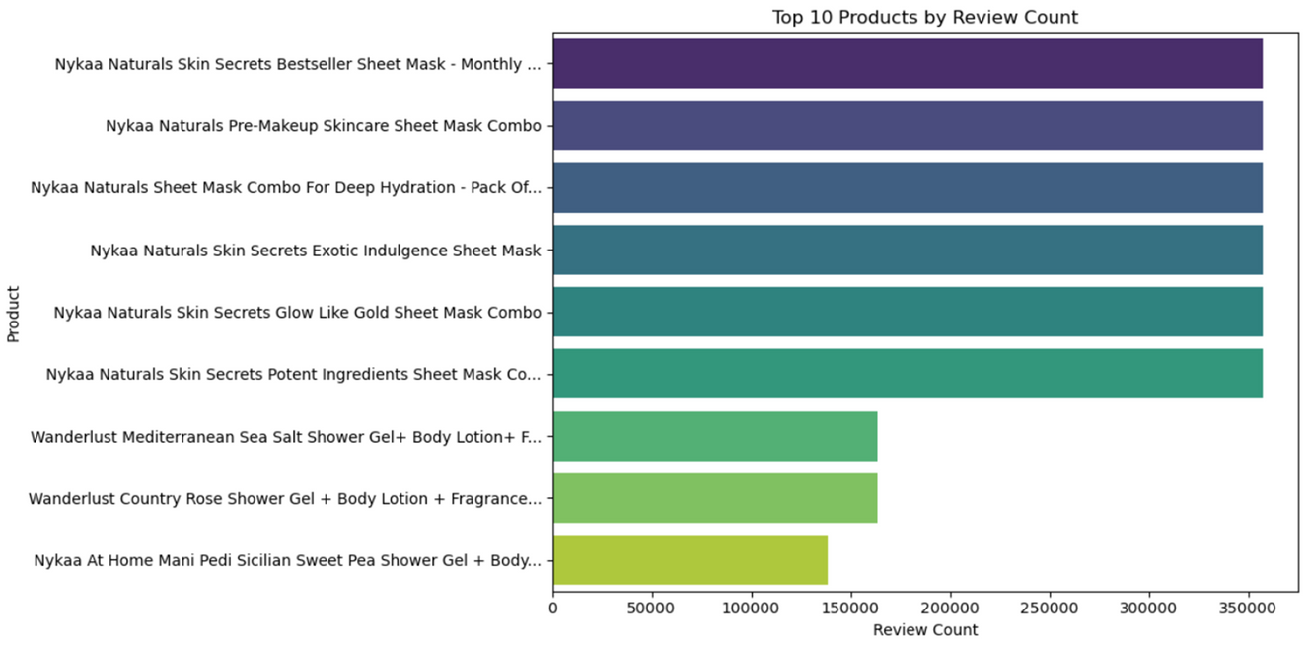


WHAT ARE THE TOP 10 PRODUCTS WITH THE HIGHEST REVIEW COUNTS?
Nykaa Naturals Skin Secrets Sheet Masks dominate the top 6 positions, showing their popularity and wide customer engagement.
The top 3 products have very similar and very high review counts (around 350,000+ reviews each).Sheet Masks are clearly the most reviewed and likely highly used product type.

Slide 15


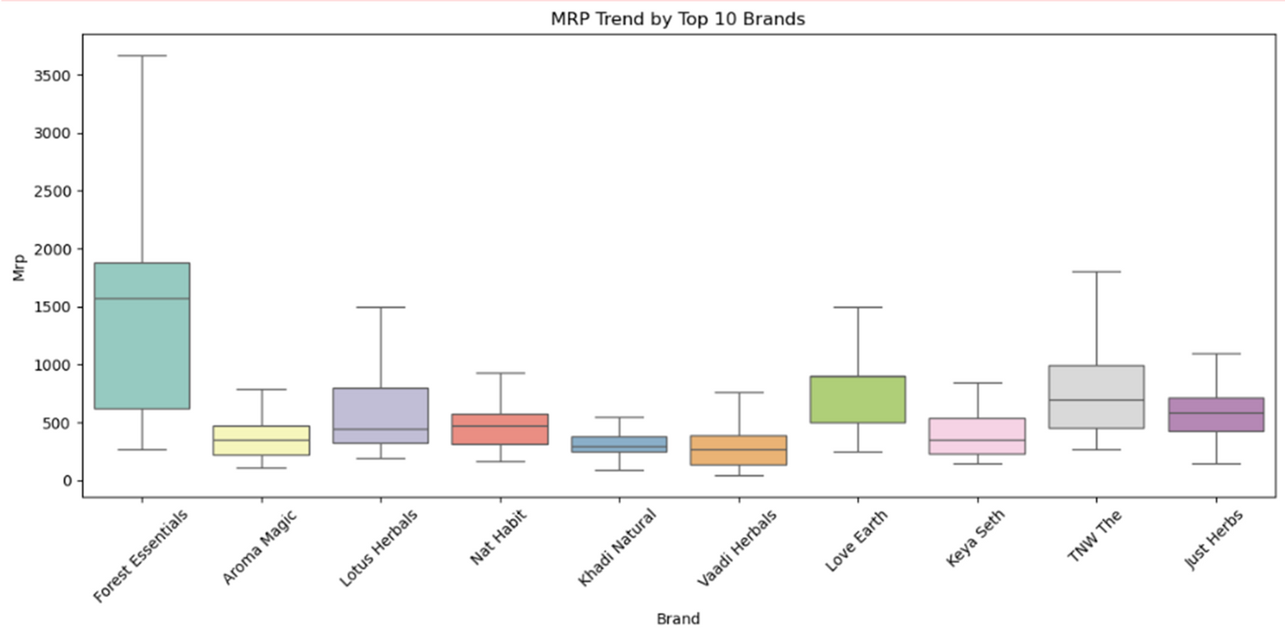

HOW HAS THE MAXIMUM RETAIL PRICE (MRP) CHANGED OVER TIME FOR THE TOP 10 MOST POPULAR PRODUCTS?
Forest Essentials has the highest average MRP and the widest price range among all brands, indicating premium pricing.
Most other brands (like Khadi Natural, Vaadi Herbals, and Aroma Magic) have lower and more consistent MRP ranges.

Slide 16


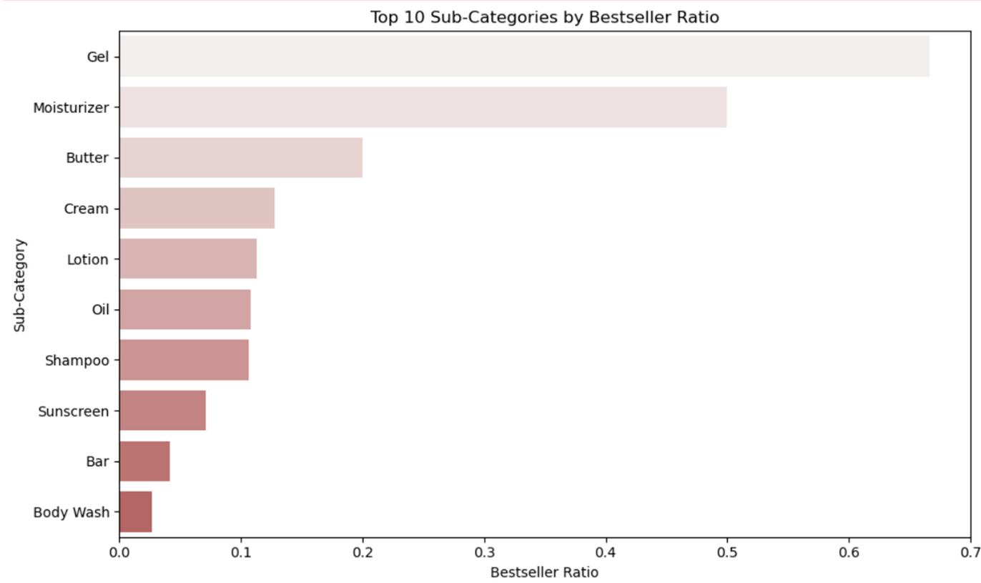


WHAT IS THE BESTSELLER RATIO FOR EACH SUB-CATEGORY?
Gel has the highest bestseller ratio among all sub-categories, by a noticeable margin.
Moisturizer and Butter also perform well, but are behind Gel.Mid-range sub-categories include Cream, Lotion, and Oil.
Shampoo, Sunscreen, Bar, and Body Wash have lower bestseller ratios.

Slide 17
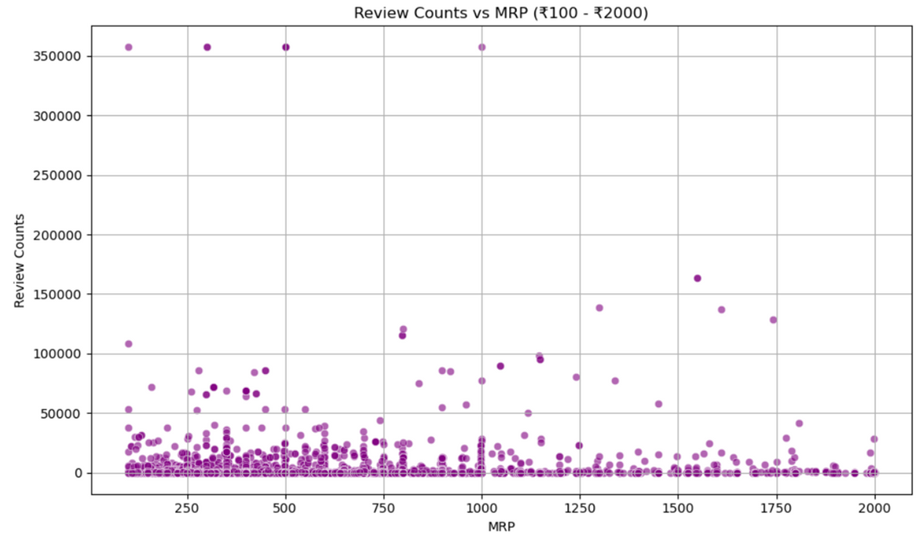
WHAT IS THE RELATIONSHIP BETWEEN PRODUCT RATINGS AND THEIR PRICES?
The highest review counts (> 350,000) are associated with products priced between ₹100–₹500, suggesting affordable products gain more traction.
Most products with high review counts (> 50,000) fall in the ₹100–₹1000 range, supporting the popularity of mid to low-priced items.
A dense cluster of products exists below ₹1000 and under 20,000 reviews, indicating the bulk of products are modestly priced with average engagement.

Slide 18

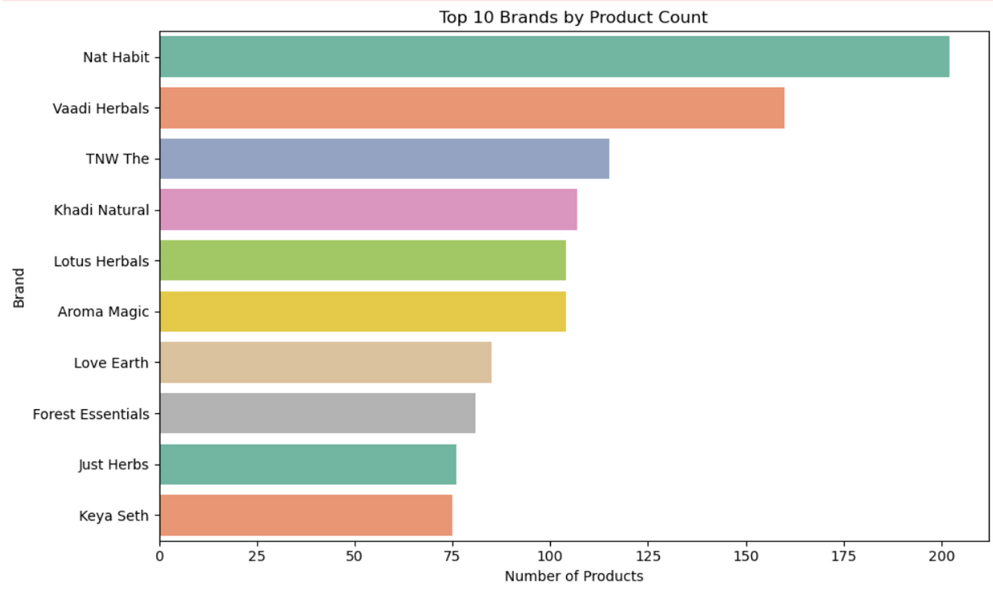


WHICH ARE THE TOP BRANDS WITH THE HIGHEST PRODUCT COUNTS?
Nat Habit is the leading brand on Nykaa in terms of product count, with over 200 products.
All top 10 brands appear to focus heavily on natural and herbal formulations, indicating a trend or customer preference on the platform.

Slide 19
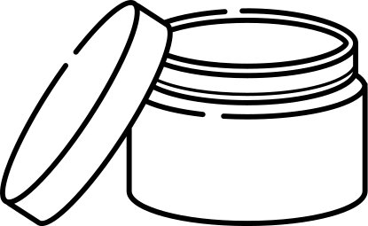
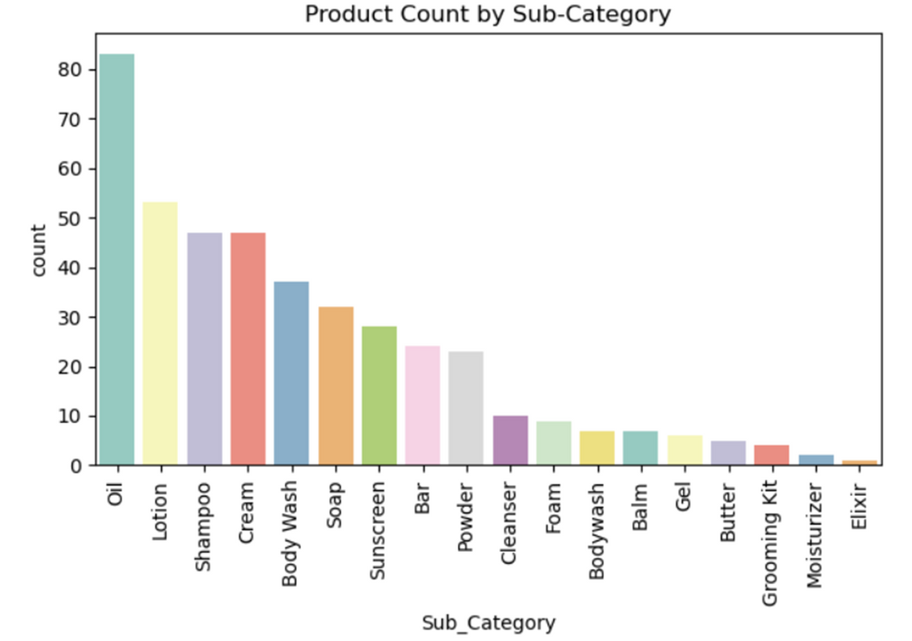
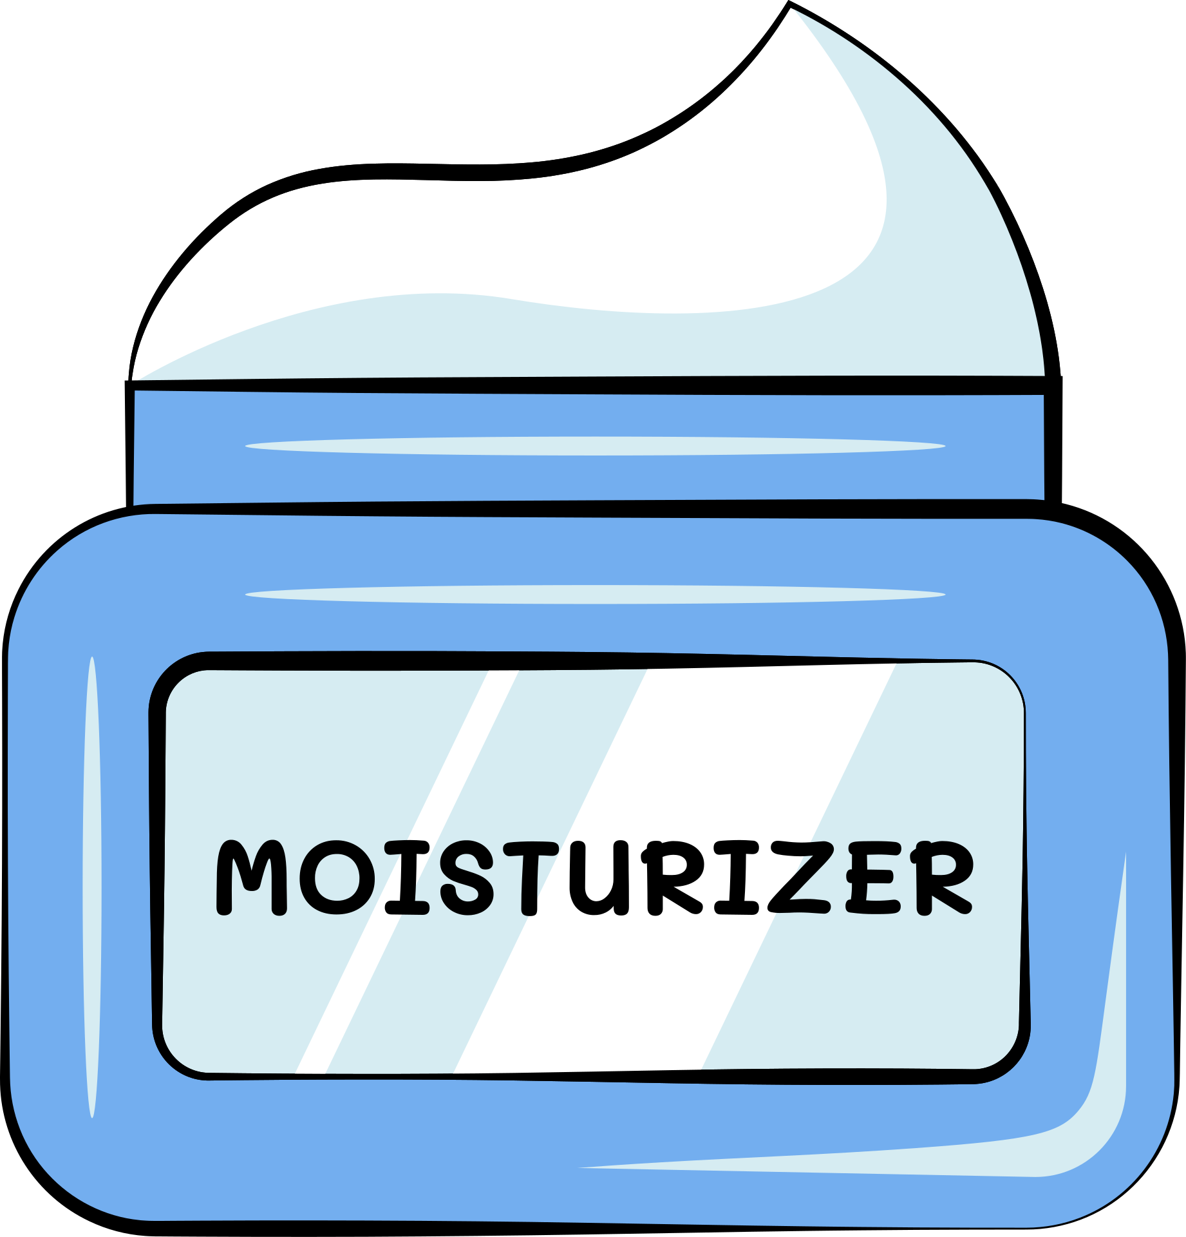
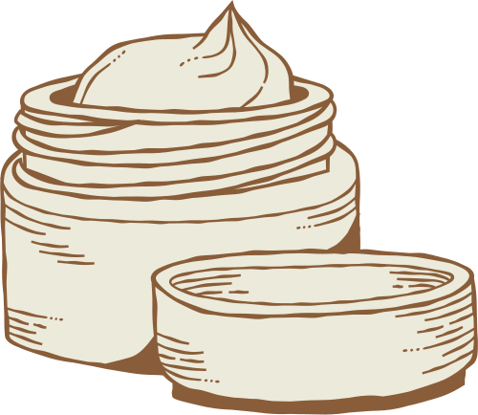
WHAT IS THE PRODUCT COUNT WITHIN EACH SUB-CATEGORY ?
Oil is the most common sub-category with over 80 products, significantly higher than others.
Sub-categories like Body Wash, Soap, and Sunscreen fall in the mid-range (30–40 products).
Grooming Kit, Moisturizer, and Elixir are the least represented, each with fewer than 5 products.

Slide 20
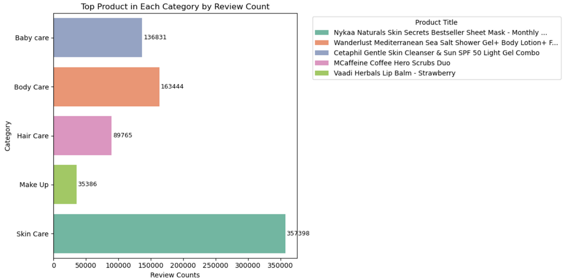
WHAT IS THE TOP PRODUCT IN EACH CATEGORY BASED ON THE REVIEW COUNT?
Skin Care once again leads significantly, with over 357,000 reviews for the product: Nykaa Naturals Skin Secrets Bestseller Sheet Mask.
Body Care is next, with around 163,000 reviews for: Wanderlust Mediterranean Sea Salt Shower Gel + Body Lotion.
Baby Care also has strong engagement with 136,831 reviews for: Cetaphil Gentle Skin Cleanser & Sun SPF Combo.

Slide 21


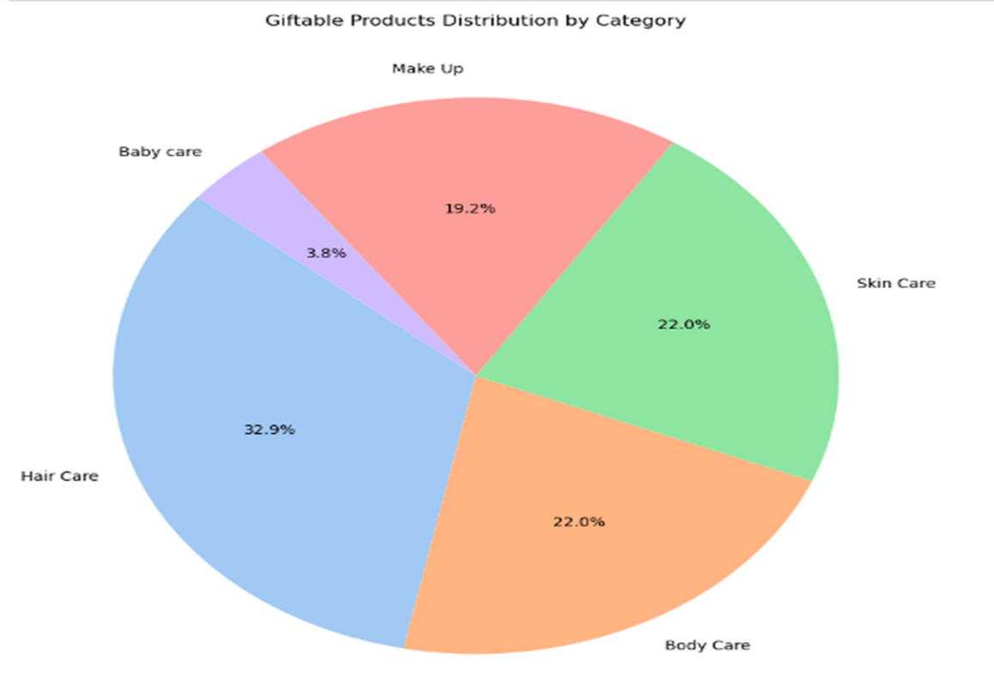

WHAT IS THE COUNT OF EACH CATEGORY OF PRODUCTS THAT PROVIDE COMPLEMENTARY GIFTS?
Hair Care is the most popular category for giftable products, making up 32.9% of the total.Skin Care and Body Care are equally important, each contributing 22.0%.
Make Up also has a decent share at 19.2%. 4.Baby Care has the smallest share, only 8%, indicating it's less commonly gifted.
Overall, Hair, Skin, and Body Care dominate the giftable product segment.

Slide 22
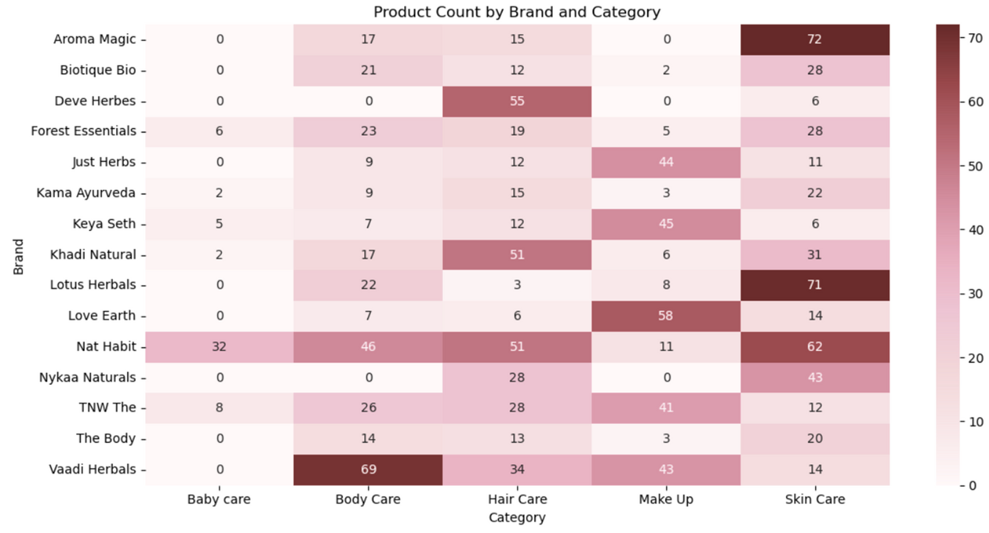
WHAT IS THE OVERALL DISTRIBUTION PATTERN OF PRODUCTS ACROSS DIFFERENT BRANDS AND CATEGORIES BASED ON THE HEATMAP?

Slide 23
Most Nykaa products are in the ₹250–₹1000 price range, showing a strong focus on affordable to mid-range items.
Creams, Shampoos, and Lotions are the most common and best-selling sub-categories across all categories.
Cetaphil, Mamaearth, Aveeno, and Sebamed are the top-performing brands with high product counts and reviews.
Products with more reviews tend to be moderately priced, not necessarily the most expensive. Giftable products are most common in Makeup and Skin Care categories.
Each category has one or two sub-categories that dominate in popularity, which can help with stock and marketing focus. Overall, customers are happy — most products have ratings above 4.0.
CONCLUSION

Slide 24
Focus on Best-Selling Sub-Categories: Prioritize popular items like creams, shampoos, and lotions, especially in the ₹250–₹1000 range, as they attract the most customers and reviews.
Promote Trusted Brands & Giftable Products: Highlight brands like Cetaphil, Mamaearth, and Aveeno, and actively market giftable products in Makeup and Skin Care during special seasons.
RECOMMENDATIONS
Review Data for Strategy: Use high review counts to identify bestsellers in each category and feature them in recommendations

Slide 25
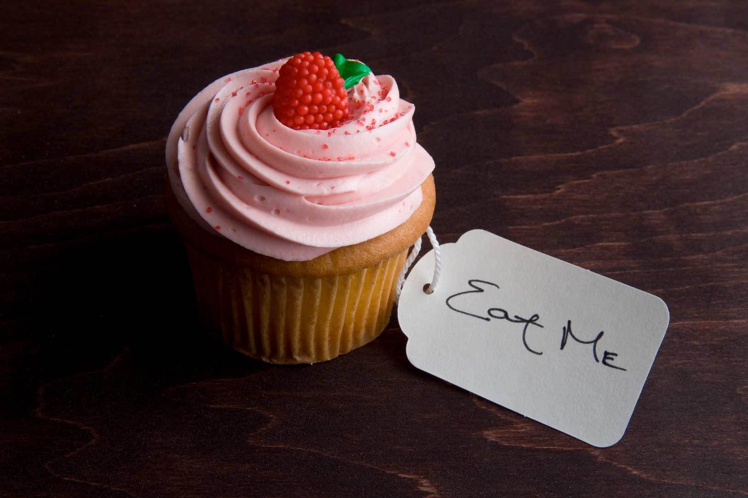
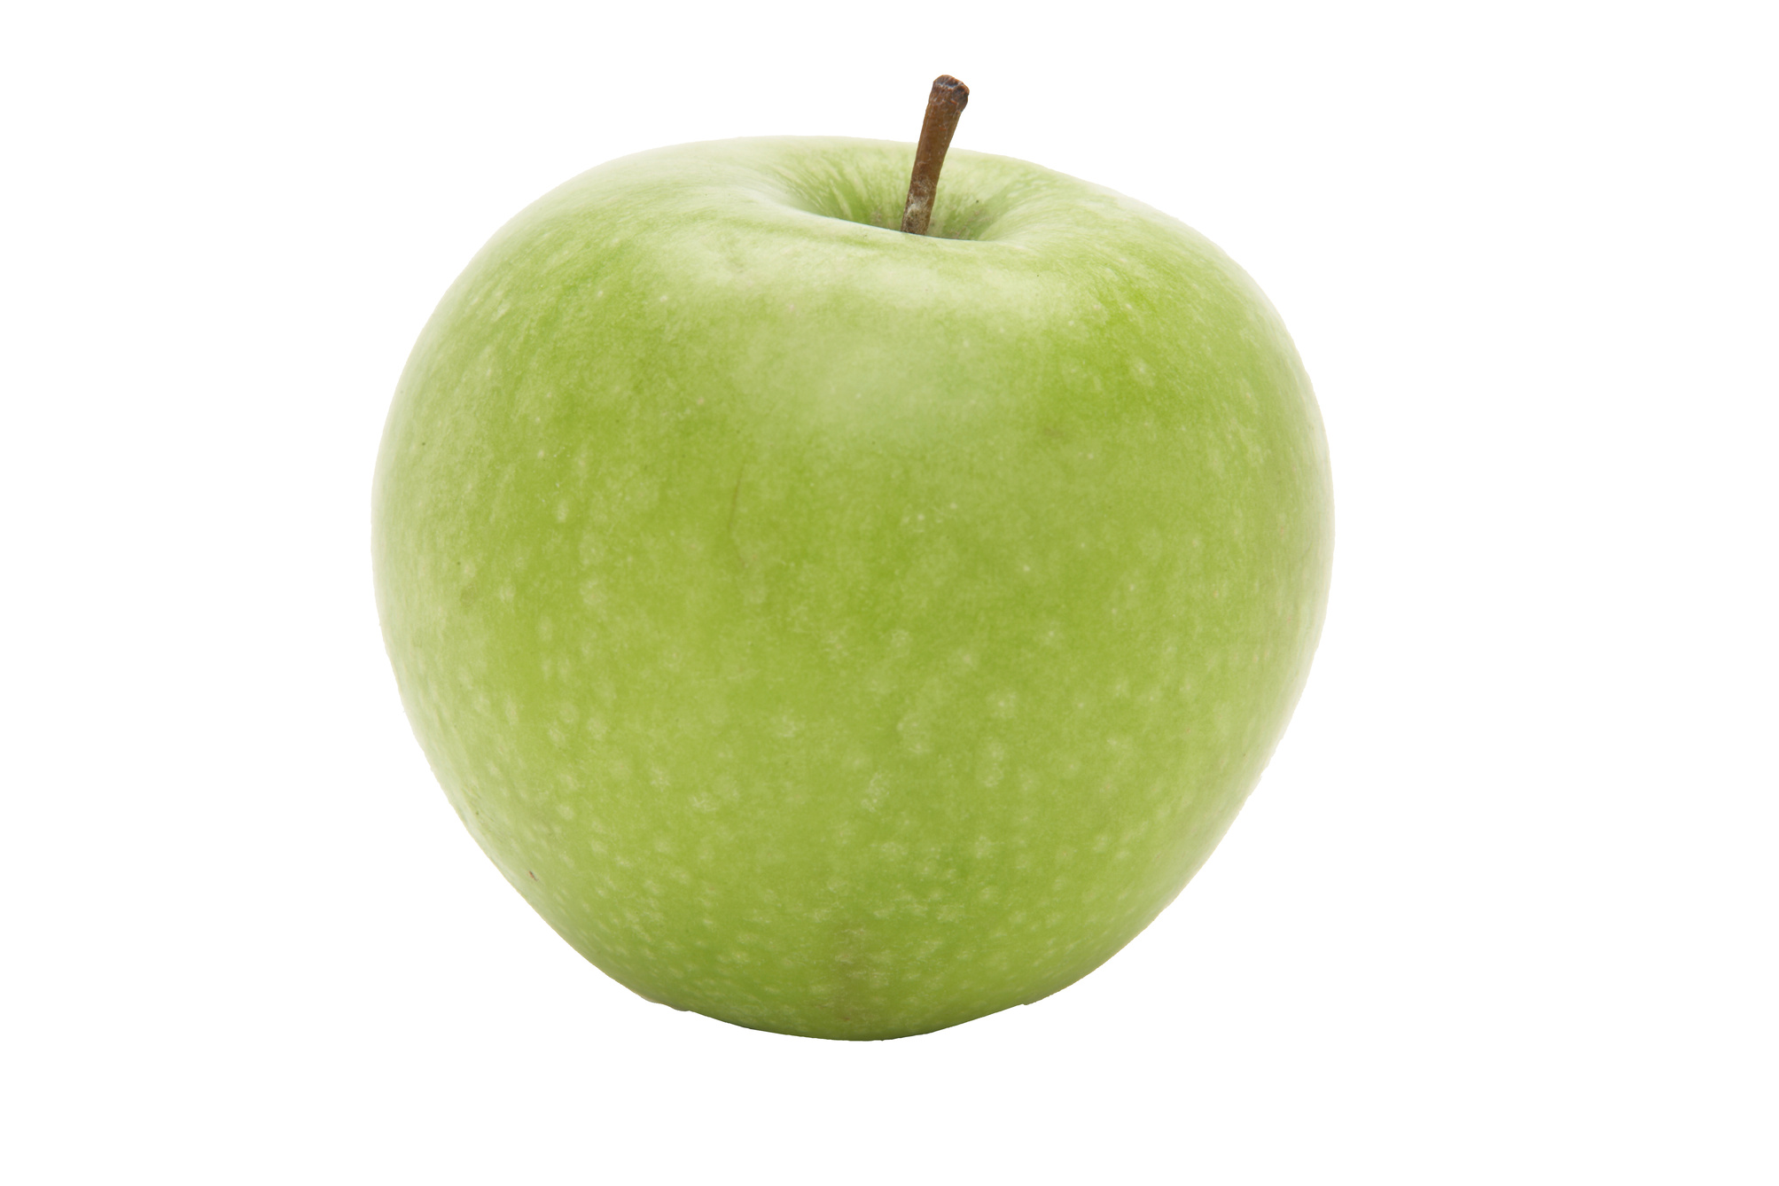

Meet Our Team
P. SRI SAI TEJASWINI
G. GURU RASAGNA
M. TARUN SAI
A. SHYAM KUMAR

Slide 26



